Slide 1

COVID-19 Vaccine: answers to your questions
A presentation for Staff and residents in post-acute and Long-Term Care

Slide 2

Why Should I get vaccinated?
Protect myself and my family
Keep my residents safe
Help stop spread in the community
Set the example for others, including residents, families, co-workers, and the community-at-large

Slide 3
common questions we Will address:
How do we know the vaccine is effective and safe?
Why should we trust the vaccine?
Is there new technology being used and is that dangerous to me?
What is an EUA and what does that mean for me?
When and how long will I be protected?
Will I still need to wear a mask?
What are the expected side effects?
What if I’ve already had COVID-19?
Where should I look to get accurate information?

Slide 4
Are the COVID-19 Vaccines Safe?
Safety is the most important priority in vaccine approval
Most side effects occur within 6 weeks of vaccination. To be more cautious, the FDA (Food and Drug Administration) requires 8 weeks of safety monitoring of the COVID-19 vaccines
Monitoring for safety will continue as the vaccine is distributed to the public
To assess safety FDA typically advises that a minimum of 3,000 participants are included in the trial. The current COVID-19 vaccine trials include 30,000 to 50,000 participants

Slide 5
How Effective are the COVID-19 Vaccines?
 | Pfizer (BNT162b2) | Moderna (mRNA-1273)
Efficacy Overall | 95% protection from having an infection | 94.1% protection from having an infection
Similar efficacy with different race, ethnicity and age

Slide 6
Who was included in the COVID-19 Vaccine Trials?
 | Pfizer (BNT162b2) | Moderna (mRNA-1273)
Number of people enrolled | Over 40,000 | Over 25,000
Race and ethnicity of participants | Total 30% racially diverse 10% black, 13% Hispanic | 37% racially diverse 10% black, 20% Hispanic/Latino
Older adults | 45% were 56-85 years | 23% were >65 years
Notes: Courtesy of Dr. Anuj Mehta, Data is accurate as of 11/18/2020. More information is constantly becoming available. Sub-group comparisons (e.g. comparisons about efficacy between races or age groups) may be less accurate due to smaller numbers. Sub-group numbers for the Pfizer vaccine are given for US participants with international percentages in parentheses.
https://www.pfizer.com/news/press-release/press-release-detail/pfizer-and-biontech-conclude-phase-3-study-covid-19-vaccine
https://www.pfizer.com/science/coronavirus/vaccine
https://investors.modernatx.com/news-releases/news-release-details/modernas-covid-19-vaccine-candidate-meets-its-primary-efficacy
https://www.modernatx.com/sites/default/files/content_documents/2020-COVE-Study-Enrollment-Completion-10.22.20.pdf

Slide 7
Why should we trust the COVID-19 Vaccine?
The FDA is using the same strict standards that it has for decades
No steps are “skipped”
Two independent advisory committees are reviewing the results. Members and experts of these committees have no conflict of interest and are not associated with any vaccine manufacturers
  The Vaccine and Related Biological Products Advisory Committee (VRBPAC) that advises the FDA
  The Advisory Committee on Immunization Practices (ACIP) that advises the CDC

Slide 8
What is an EUA and what does that mean for me?
An Emergency Use Authorization (EUA) for a vaccine is based on the need to use a vaccine quickly to save lives during a public health emergency
EUA is a shorter process but no steps are skipped in the safety evaluation process
The FDA will assess if the vaccine known and potential benefits outweigh the known and potential risks
Two separate advisory boards (VRBPAC and ACIP) will also review the data and make recommendations
An EUA does NOT imply that the authorization was done too quickly or that the vaccine is not safe

Slide 9
How was the vaccine developed so quickly?
Major reasons we were able to get these vaccines developed more quickly than usual include :
  Global effort with the world’s leading scientists focused on a single task
  Nearly unlimited resources (money, knowledge, manpower, technology)
  A large pool of diverse adult volunteer trial participants

Slide 10
The First two COVID-19 Vaccines
Both are mRNA vaccines
Pfizer (BNT162b2)
Moderna (mRNA-1273)
They Do NOT contain COVID-19 virus

Slide 11
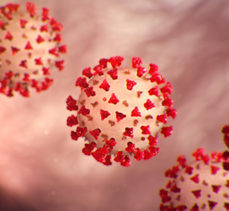
COVID-19 Vaccine is mRNA VACCINE- WHAT IS THAT?
mRNA COVID-19 Vaccines
  mRNA technology is new in vaccine production but is already being used in cancer treatment. It has been studied for more than ten years.
  COVID-19 mRNA vaccines give instructions for our cells to make a harmless piece that looks like the “spike protein.” The spike protein is found on the surface of the COVID-19 virus.
  Our bodies recognize that this protein should not be there, so they build antibodies that will remember how to fight the virus that causes COVID-19 if we are infected in the future.
  Can mRNA vaccine give me COVID-19? NO
  Can mRNA vaccine change my DNA? NO
Notes:
Check CDC

Slide 12
When and how long will I be protected by the COVID-19 Vaccine?
Most of the vaccines are 2 doses, 3-4 weeks apart
Protection occurs 1-2 weeks after the second dose
We will most likely not know how long the vaccine will be protective once we receive it. We will know more as more time passes in the current research
May need to have vaccine shots for COVID-19 on a regular basis (like the flu shot)

Slide 13
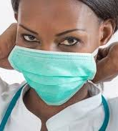
Will I Still need to wear a Mask?
YES !
Similar to other vaccines, a large number of people in the community will need to get vaccinated before transmission drops enough to stop the use of masks

Slide 14
What should I Expect When I Get the vaccine?
THE VACCINE CANNOT GIVE YOU COVID-19!
You can expect to have short-term discomfort: fatigue, headache, muscle pain, chills, fever and pain at injection site after vaccination
These reactions will last for 24-48 hours and are typically more pronounced after the second dose
Side effects mean your body is doing its job and making antibodies (IT IS A GOOD THING)
These side effects are normal, common and expected

Slide 15
Most Common side effects
Based on Data from clinical trial of Pfizer COVID-19 Vaccine
Fever: 4-16%
Fatigue 34-59%
Headache: 25-52%
Muscular pain: 14-37%
Side effects were more common after the second dose of the vaccine.
Reference: Data published in the New England Journal of Medicine: https://www.nejm.org/doi/full/10.1056/NEJMoa2034577

Slide 16
What should I Expect When I Get the vaccine?
YOU MUST GET THE SECOND DOSE because the vaccine will not protect you if only get one dose
It is important to get the SAME VACCINE as the first dose

Slide 17
Special circumstance
What if I already had covid-19?
It is safe to get the COVID-19 vaccine even if you have had COVID-19
Even if you have had COVID-19, it is important to get vaccinated. It could give you longer or better protection against the disease
Even if you have positive antibodies, you should get the COVID-19 vaccine

Slide 18
Where should I look to get accurate information?
It is important to get information from reliable sources (CDC, AMDA, medical directors, providers) Social media is full of misinformation and opinions based on that misinformation
Here are some link to information:
CDC: https://www.cdc.gov/vaccines/hcp/covid-conversations/answering-questions.html
CDC: About COVID-19 vaccines: https://www.cdc.gov/coronavirus/2019-ncov/vaccines/about-vaccines.html
CDC: Provider Resources for COVID-19 Vaccine Conversations with Patients and Answering Patients’ Questions: https://www.cdc.gov/vaccines/hcp/covid-conversations/

Slide 19
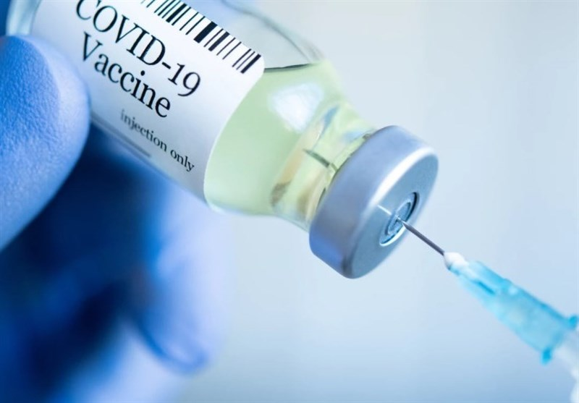
Vaccines Are the only way to control the COVID-19 Pandemic
Everyone has to do their part and get vaccinated to get back to a normal life

Slide 20

Questions?

